Slide 2
issue
1.单词知道，它有其他意思，你不知道
2. 单词知道，但往往是和别的词作为一个整体出现，你不知道这种常用搭配，自然很难get意思
3. 这个单词你不熟悉，但你有熟悉的单词与其有相近的意思
4. 单词你知道，但在不懂时态中的变形你get不到
5.单词你知道，但它的名词，副词形式你不知道

Slide 3
wage
wake
walk
wall
wander
want
war
ward
wardrobe
warm
warn
waste
wave
weakness
wear
weather
wedding
weigh
weight
weird
welfare
west
western
wet
whatsoever
wheel
whereas
while
whisky
whisper
white
whose
wicked
wide
widely
widespread
wild
will
willing
wind
windy
wine
wing
winter
wipe
wire
wise
witness
wonder
wool
word
worth
would
wound
wonder
wrap
write
writer
writing

Slide 4
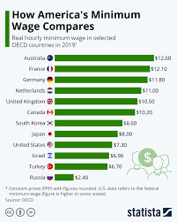
wage
Wrap
minimum wage
money you earn that is paid according to the number of hours, days, or weeks
wage

Slide 5
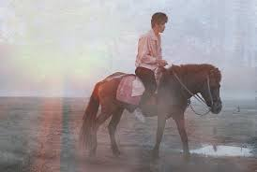
wander
Wrap
to walk slowly across or around an area, usually without a clear direction or purpose
wander

Slide 6
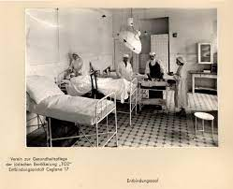
ward
Wrap
a large room in a hospital where people who need medical treatment stay
one of the small areas that a city has been divided into for the purpose of local elections
someone, especially a child, who is under the legal protection of another person or of a law court
ward

Slide 7

wardrobe
Wrap
a piece of furniture like a large cupboard that you hang clothes in
wardrobe

Slide 8
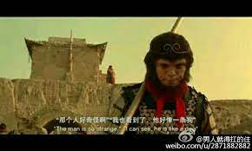
weird
Wrap
very strange and unusual, and difficult to understand or explain
weird

Slide 9

wicked
Wrap
behaving in a way that is morally wrong
wicked
weekend
kid
SYN
evil

Slide 10
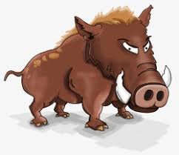
wild
Wrap
living in a natural state, not changed or controlled by people
not used by people for farming, building etc
feeling or expressing strong uncontrolled emotions, especially anger, happiness, or excitement
behaving in an uncontrolled, sometimes violent way
wild

Slide 11
whatsoever
Wrap
used to emphasize a negative statement
whatsoever
whatever

Slide 12
whereas
Wrap
used to say that although something is true of one thing, it is not true of another
used at the beginning of an official document to mean ‘because of a particular fact’
whereas

Slide 13
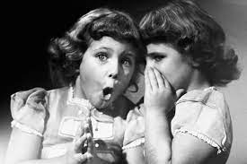
whisper
Wrap
to speak or say something very quietly, using your breath rather than your voice
to say or suggest something privately or secretly
whisper

Slide 14
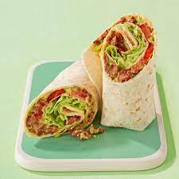

wrap
W
to put paper or cloth over something to cover it
if you wrap your arms, legs, or fingers around something, you use them to hold it
wrap
Notes:
"Wrap it up" 是一个常用的口头表达，通常用来表示结束某个活动、会议、对话或任务。它的含义是告诉人们尽快完成正在进行的事情，不要再继续延长或拖延。这个短语可以在各种情境下使用，包括以下几种情况：
会议或演讲：主持人或组织者可能会告诉演讲者或与会者 "Let's wrap it up"，以表示他们需要结束讲话或会议。
影视制作：导演可能会对演员和摄制组说 "Let's wrap it up" 来宣布拍摄工作的结束。
对话：在对话中，某人可能会说 "I need to wrap it up" 来表示他们需要结束谈话并离开。
任务或工作：在工作场合，上级或同事可能会告诉你 "Wrap it up"，表示你需要完成当前的任务或项目。
总之，"wrap it up" 是一种通用的表达方式，用来提醒人们结束正在进行的事情，通常是出于时间、进度或其他方面的考虑。

Slide 15

wind
moving air, especially when it moves strongly or quickly in a current
wind

Slide 16
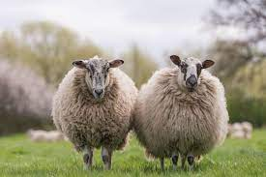

wool
the soft thick hair that sheep and some goats have on their body
material made from wool
thread made from wool that you use to knit clothes
wool

Slide 17
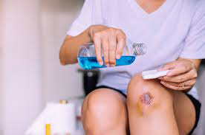
wound
an injury to your body that is made by a weapon such as a knife or a bullet
a feeling of emotional or mental pain that you get when someone says or does something unpleasant to you
wound

Slide 18
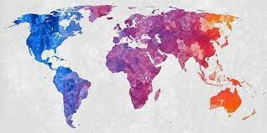
widespread
existing or happening in many places or situations, or among many people
widespread

Slide 19
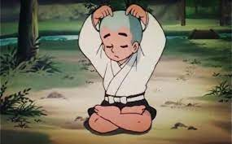
wise
wise decisions and actions are sensible and based on good judgment
wise

Slide 20

wire
thin metal in the form of a thread, or a piece of this
a piece of metal like this, used for carrying electrical currents or signals
wire
wireless

Slide 21
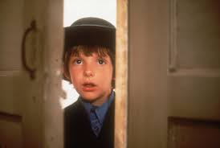
witness
someone who sees a crime or an accident and can describe what happened
witness

Slide 22

wonder
to think about something that you are not sure about and try to guess what is true, what will happen etc
to feel surprised and unable to believe something
wonder

Slide 23
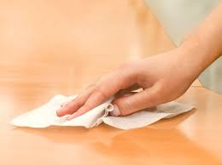
wipe
to rub a surface with something in order to remove dirt, liquid etc
wipe

Slide 24
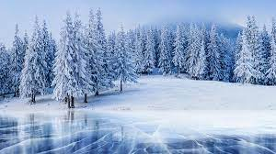
winter
the season after autumn and before spring, when the weather is coldest
winter

Slide 25

welfare
someone’s welfare is their health and happiness
help that is provided for people who have personal or social problems
money that is paid by the government in the US to people who are very poor or unemployed
welfare

Slide 26

whisky
a strong alcoholic drink made from grain, or a glass of this
whisky

Slide 27
whisky
to ask someone a lot of questions about something
grill

Slide 28
address
address
the details of the place where someone lives or works, which you use to send them letters etc
to speak to someone directly
if you address a problem, you start trying to solve it
address

Slide 29
revenue
money that a business or organization receives over a period of time, especially from selling goods or services
revenue
Special revenues

Slide 30
desperate
Wrap
willing to do anything to change a very bad situation, and not caring about danger
needing or wanting something very much
desperate
desperately
Notes:
The doctors tried desperately to save her life.

Slide 31
expect
Wrap
to think that something will happen because it seems likely or has been planned
expect
expectation

Slide 32
convince
Wrap
to make someone feel certain that something is true
convince
highly convinced that

Slide 33
capable
able to do things well

Slide 34


reputation
the opinion that people have about someone or something because of what has happened in the past

Slide 35
heavily
in large amounts, to a high degree, or with great severity
very

Slide 36
profit
money that you gain by selling things or doing business, after your costs have been paid
profitable
producing a profit or a useful result
profitable

Slide 37
sustain
to make something continue to exist or happen for a period of time
sustainable
able to continue without causing damage to the environment
sustainable
maintain

Slide 38
continuous
continuing to happen or exist without stopping
continuous

Slide 39
consistent
always behaving in the same way or having the same attitudes, standards etc – usually used to show approval
consistent

Slide 40
further
more, or to a greater degree
further

Slide 41
prevent
to stop something from happening, or stop someone from doing something
prevent

Slide 42
therefore
as a result of something that has just been mentioned
therefore

Slide 43
heat
to make something become warm or hot
heat
heat up

Slide 44
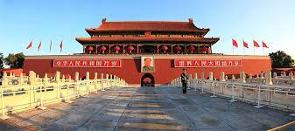
forbidden
forbidden
forbidden city

Slide 45

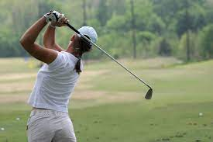
forbidden
swing
full swing

Slide 46

forbidden
steep

Slide 47

forbidden
spray

Slide 48
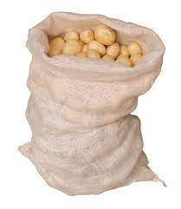
forbidden
sack

Slide 49
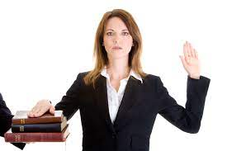
swear
swear

Slide 50
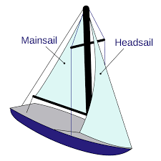
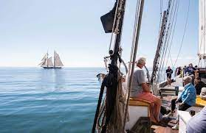
forbidden
sail

Slide 51
forbidden
sake
for the sake of
= For the purpose of

Slide 52
sustain
sustain
self-sustained

Slide 53
forbidden
arrest
for the sake of
= For the purpose of

Slide 54
forbidden
accuse
for the sake of
= For the purpose of

Slide 55

forbidden
awkward

